Slide 1
Parallel Programming Final Project – Parallel Sudoku Solver
Dec. 15th 2022
Speaker:呂承哲
Group 3 Members: 呂承哲, 劉紘華, 邱恆毅

Slide 2
Outline
Introduction
Related Works
Methodology
Experimental Results
Conclusion

Slide 3
Outline
Introduction
Related Works
Methodology
Experimental Results
Conclusion

Slide 4
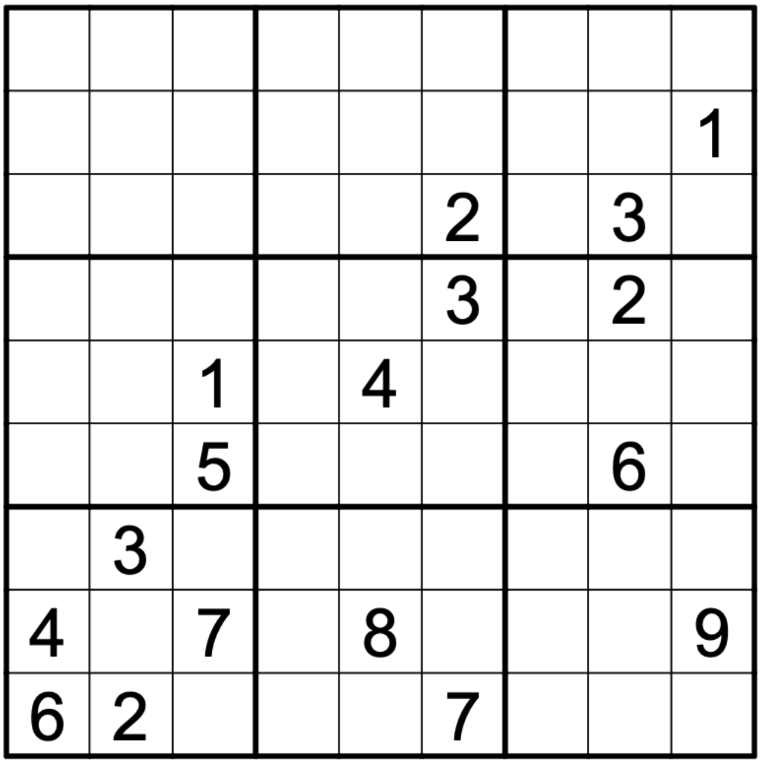
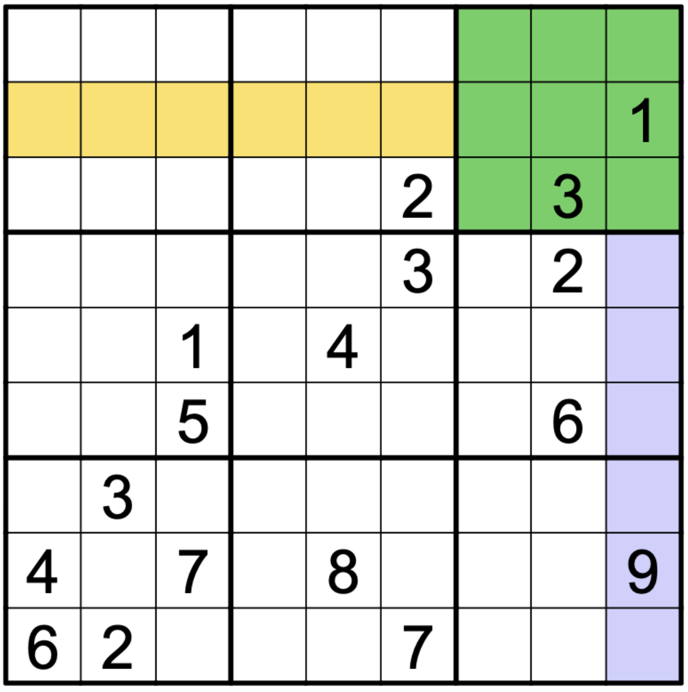
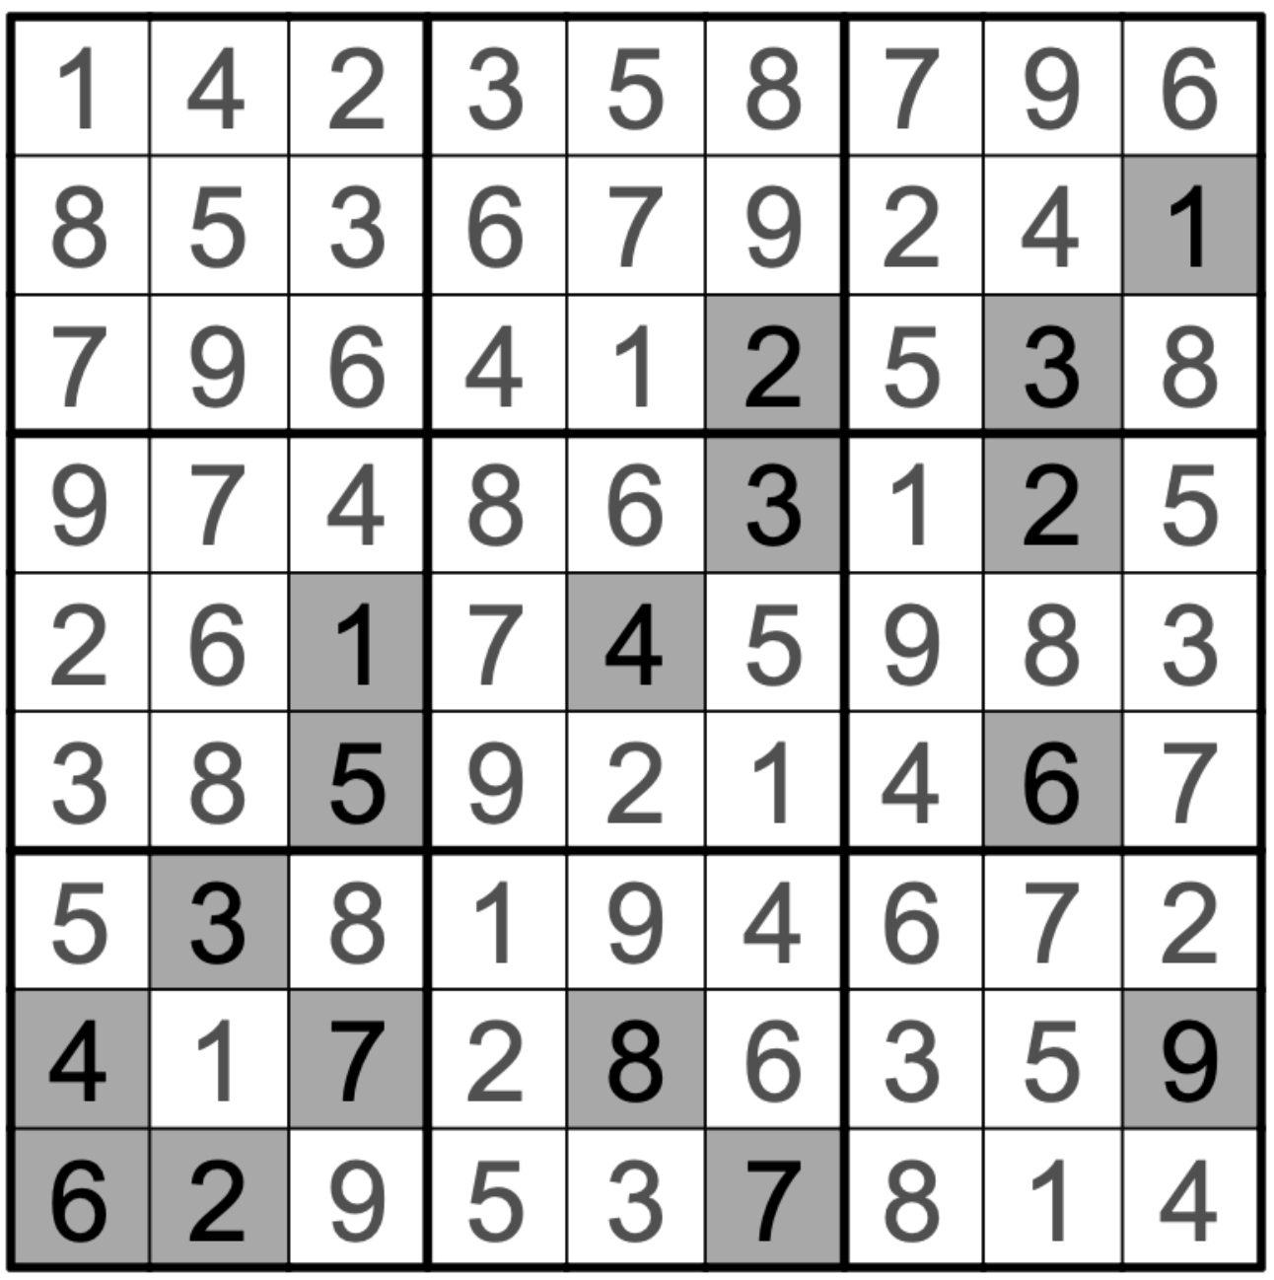
Introduction
Sudoku
A number-placement puzzle whose objective is to fill a 9x9 grid with digits so that each row, column and 3x3 subgrid contains all the digits from 1 to 9.

Slide 5
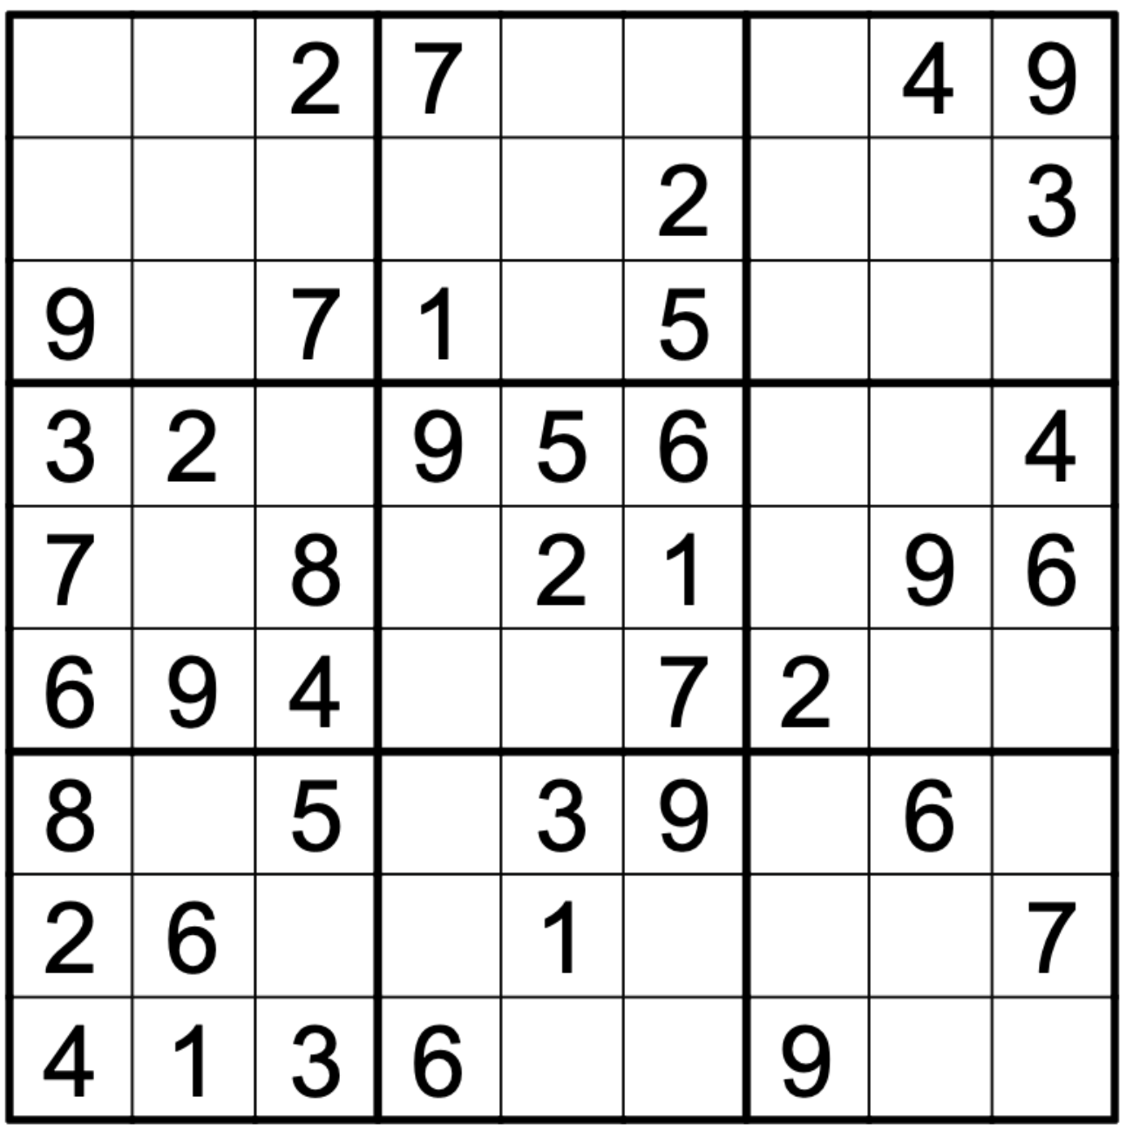
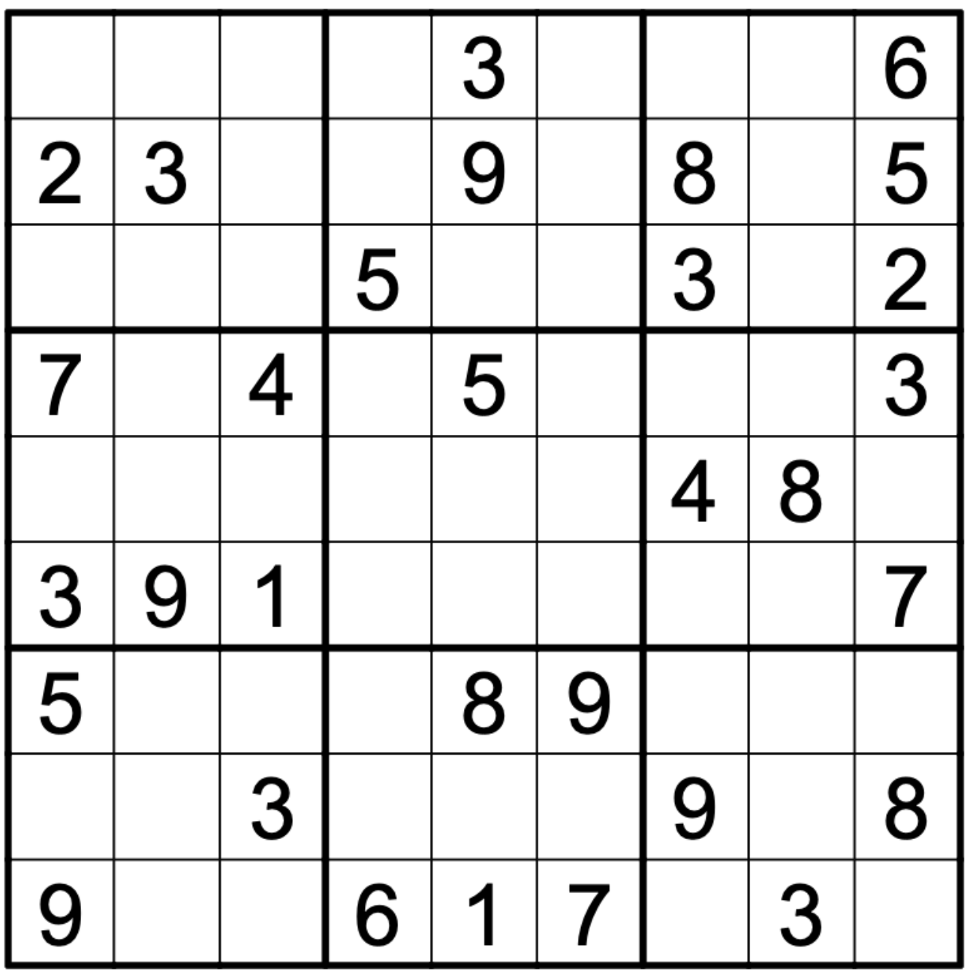
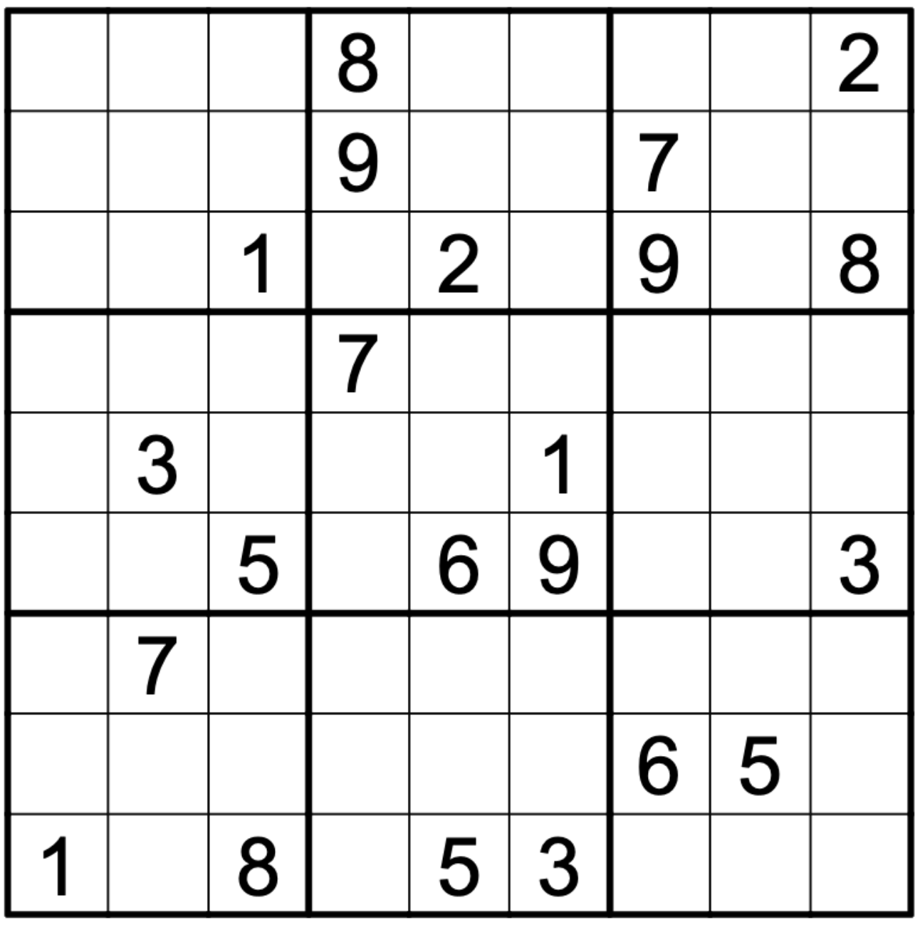
Introduction
Problem Formulation
For an unsolved sudoku, find its solution as soon as possible (response time)
Combine efficient serial algorithm with parallel computation

Slide 6
Outline
Introduction
Related Works
Methodology
Experimental Results
Conclusion

Slide 7
Related Works
Solving graph coloring problems with the Douglas-Rachford algorithm
Francisco J. Aragón Artacho and Rubén Campoy in 2016
Solving sudoku could be regarded as a graph coloring problem
However, sudoku problem is too specific to have real life application

Slide 8
Related Works
Serial-based sudoku solver algorithm
Parallel-based sudoku solver algorithm

Slide 9
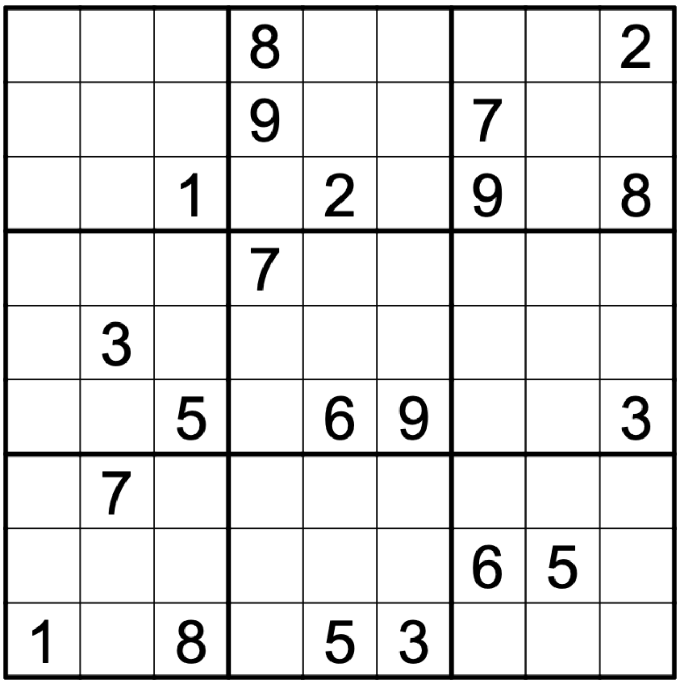
Related Works
Serial-based algorithm
Backtracking – search for all possibility in a brute force way (DFS)

Slide 10
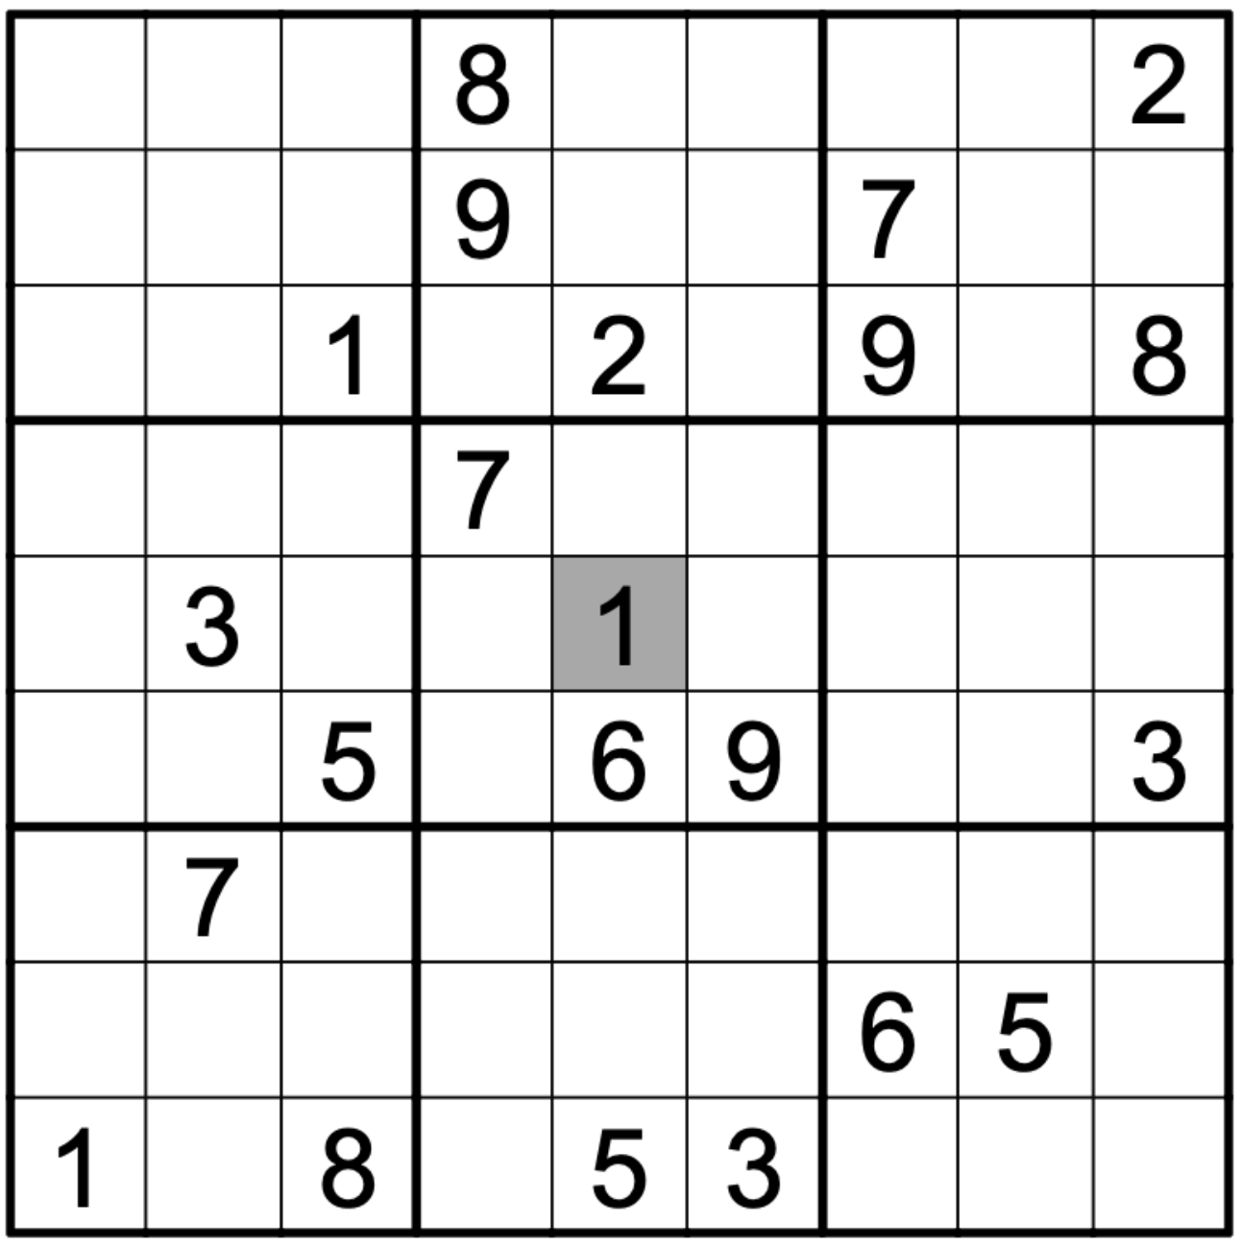
Related Works
Serial-based algorithm
Backtracking – search for all possibility in a brute force way (DFS)

Slide 11
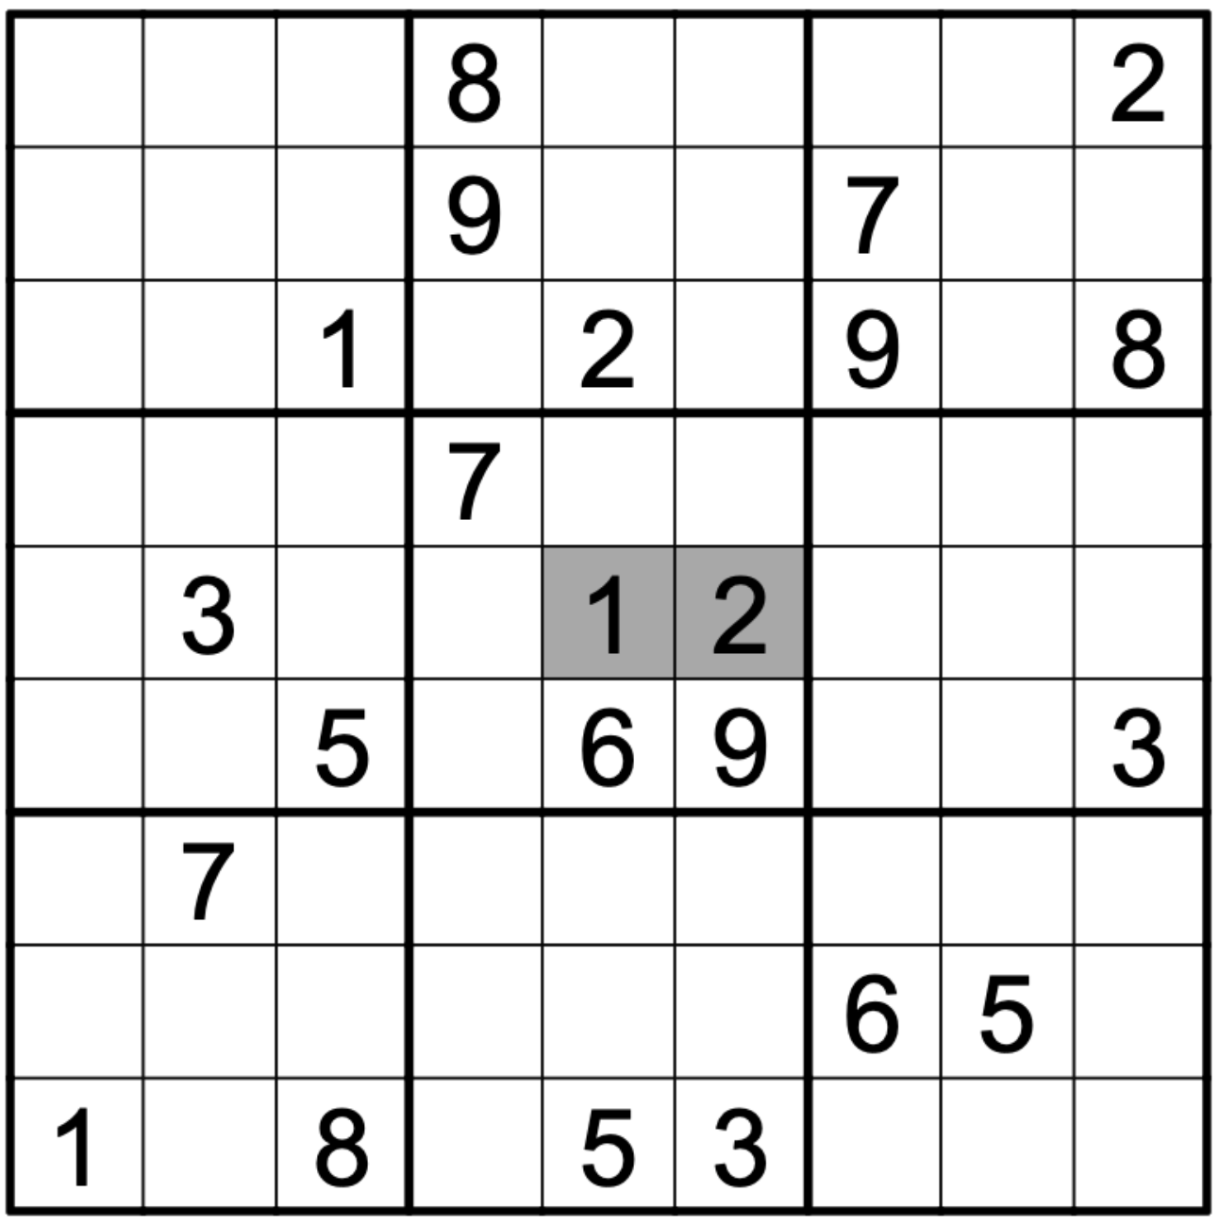
Related Works
Serial-based algorithm
Backtracking – search for all possibility in a brute force way (DFS)

Slide 12
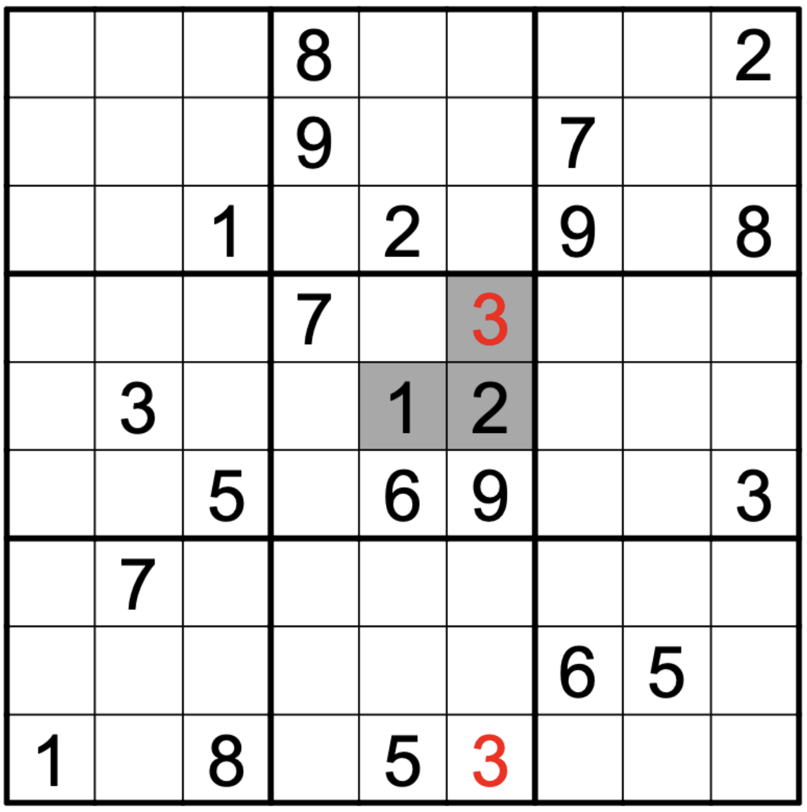
Related Works
Serial-based algorithm
Backtracking – search for all possibility in a brute force way (DFS)

Slide 13
Related Works
Serial-based algorithm
Backtracking – search for all possibility in a brute force way (DFS)

Slide 14
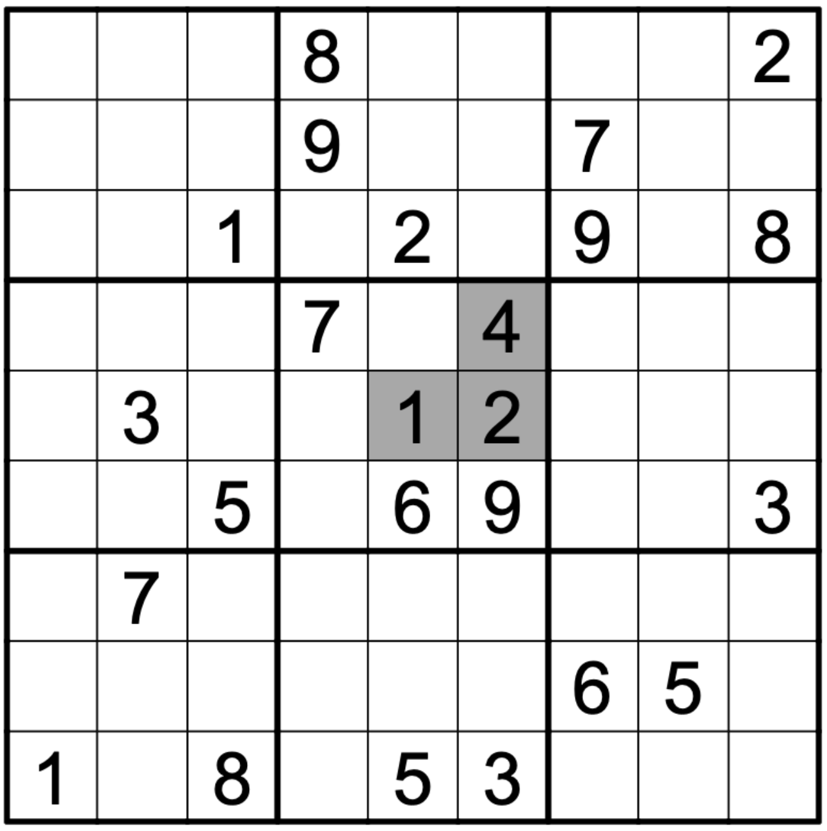
Related Works
Serial-based algorithm
Backtracking – search for all possibility in a brute force way (DFS)

Slide 15
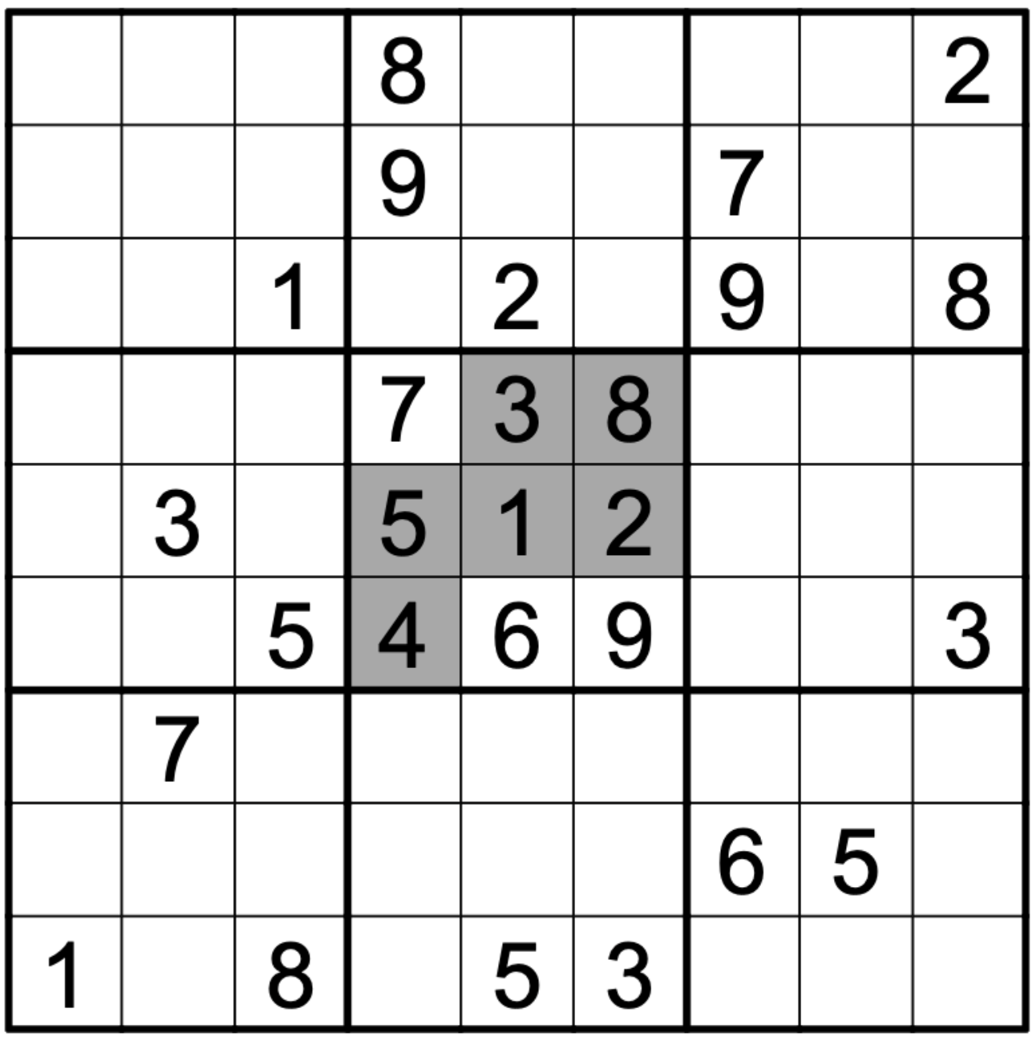
Related Works
Serial-based algorithm
Backtracking – search for all possibility in a brute force way (DFS)

Slide 16
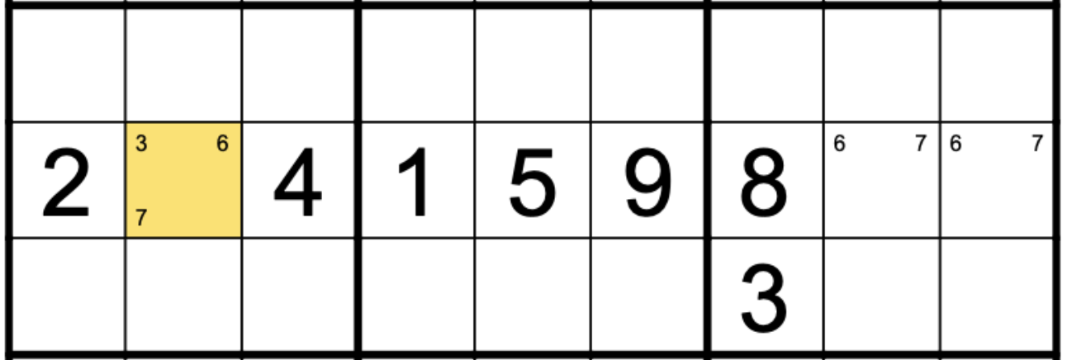
Related Works
Serial-based algorithm
Crooks algorithm – rule-based eliminations to prune the search space

Slide 17
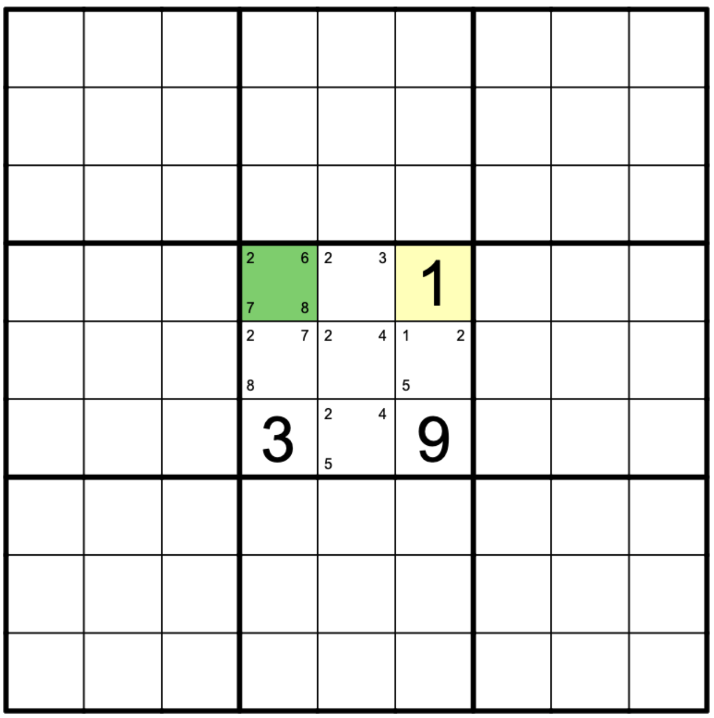
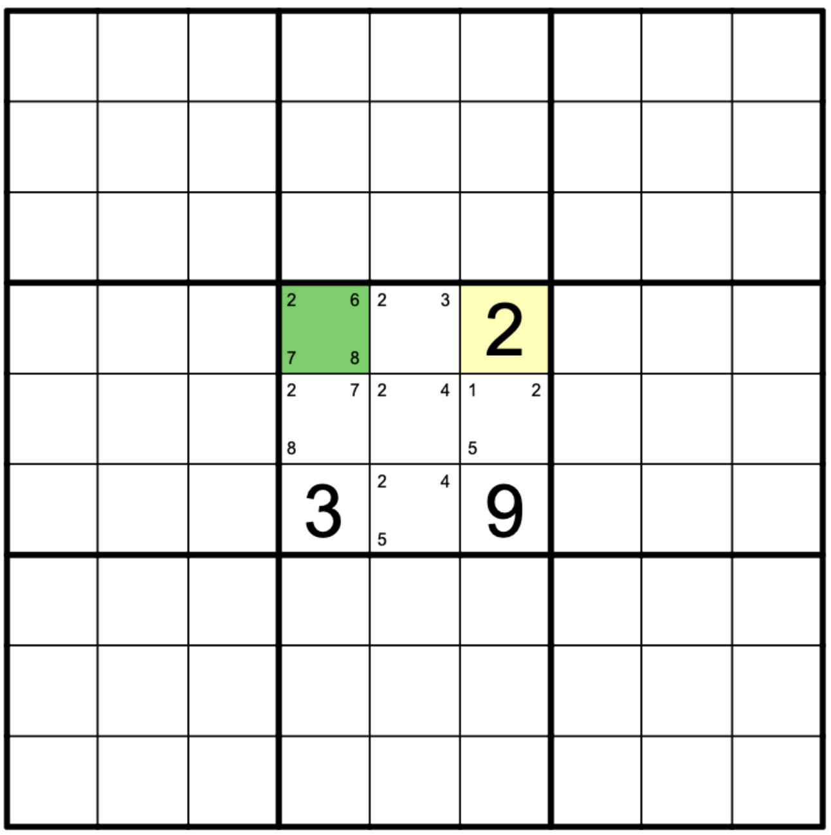
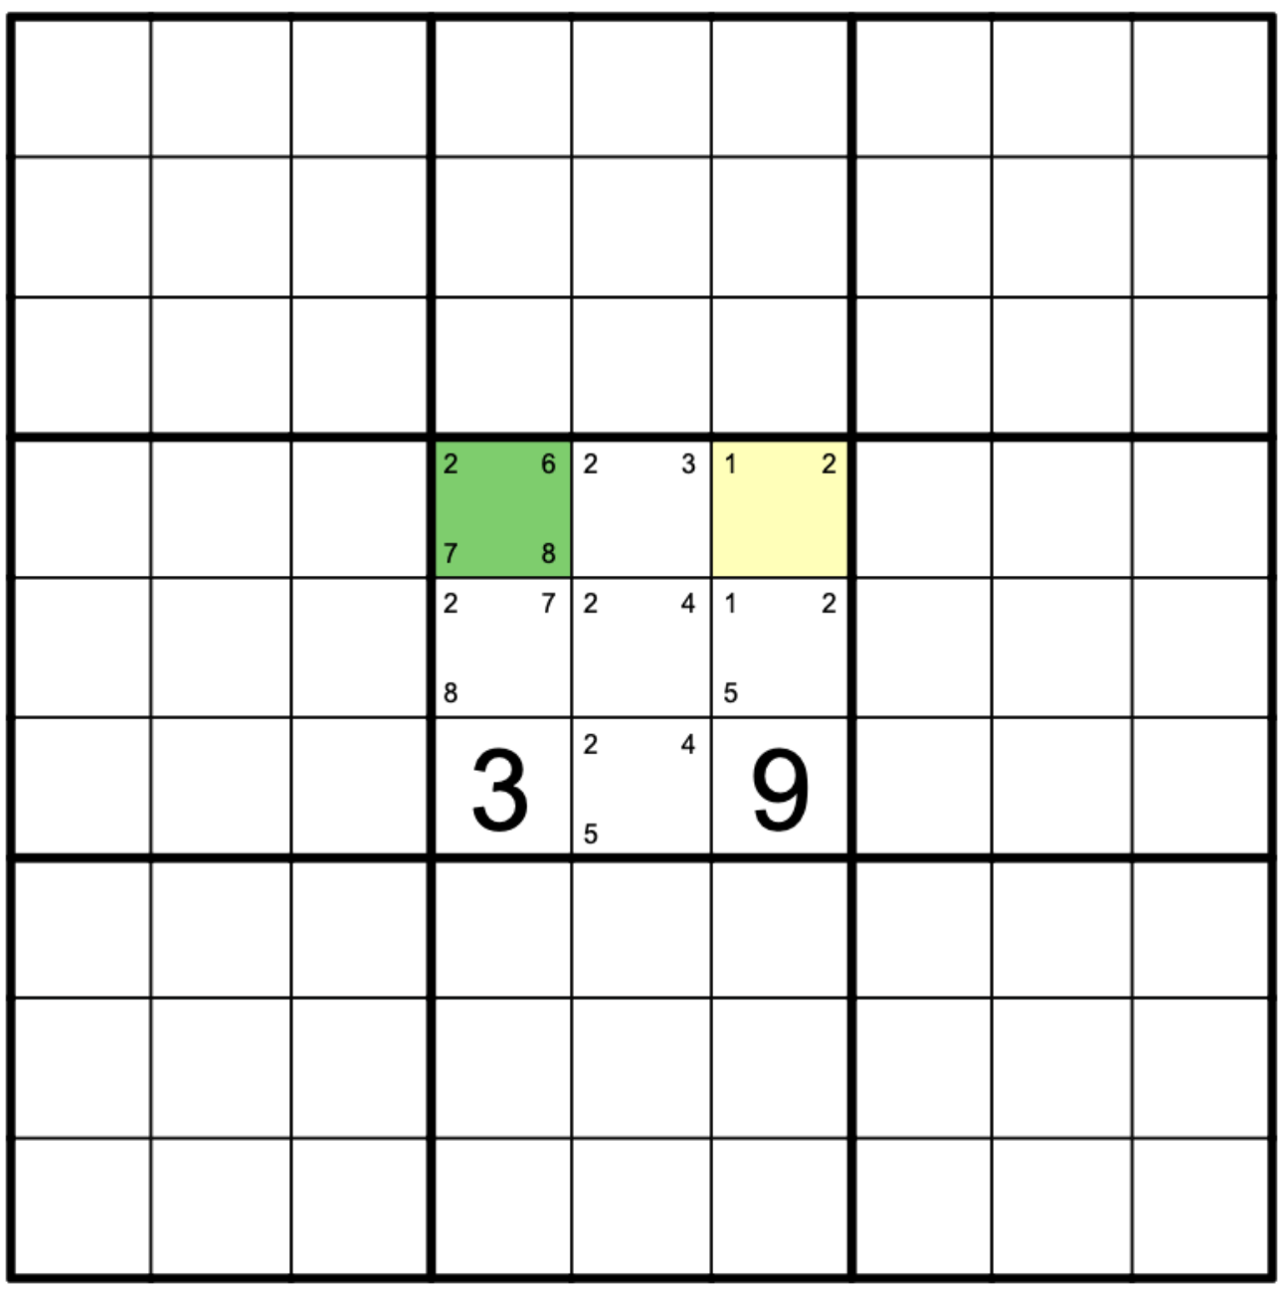




Related Works
Serial-based algorithm
Cross-hatching – pick the almost-filled element first for better pruning

Slide 18
Related Works
Serial-based algorithm
Backtracking – search for all possibility in a brute force way (DFS)
Crooks algorithm – rule-based eliminations to prune the search space
Cross-hatching – pick the almost-filled element first for better pruning
Other techniques
Davis-Putnam-Logemann-Loveland (DPLL) Algorithm
Strongly Connected Components
…

Slide 19
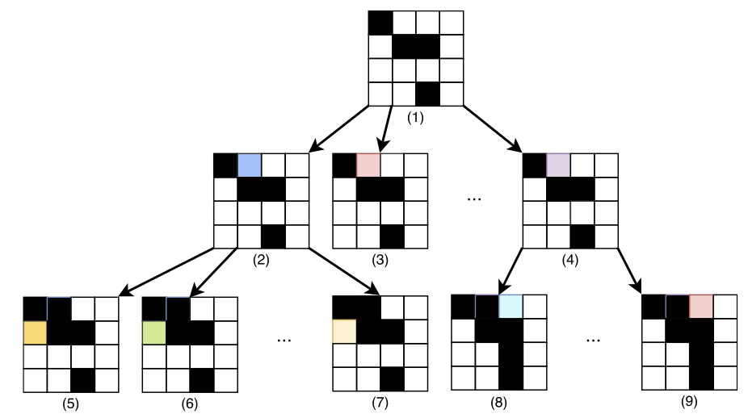
Related Works
Parallel-based optimizations
Shared-memory communication
Parallelization of a Sudoku Solver
Hua-Ming Huang, 2021
Pre-split the search space & solve them parallelly
Dancing links data structure is used
Only simple backtracking solver is used
Solve time: ~1 seconds

Slide 20
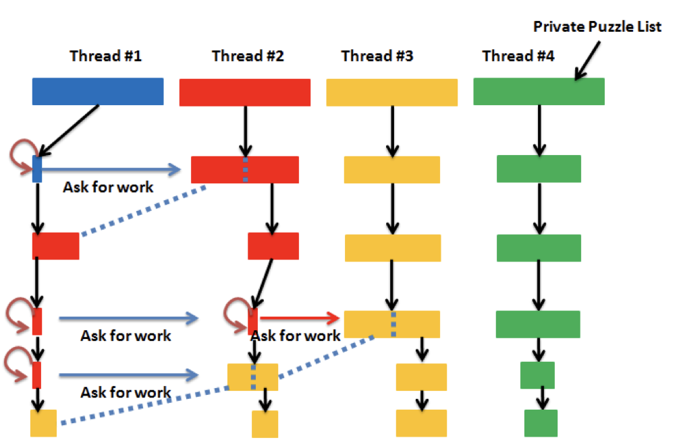
Related Works
Parallel-based optimizations
Message-passing communication
Parallelization of Sudoku
Alton Chiu, et al., 2012
Dynamically split the search space
Crooks algo & cross-hatching are used
Target on 16x16 large sudoku puzzle
Extremely large search space
Solve time: ~10 seconds

Slide 21
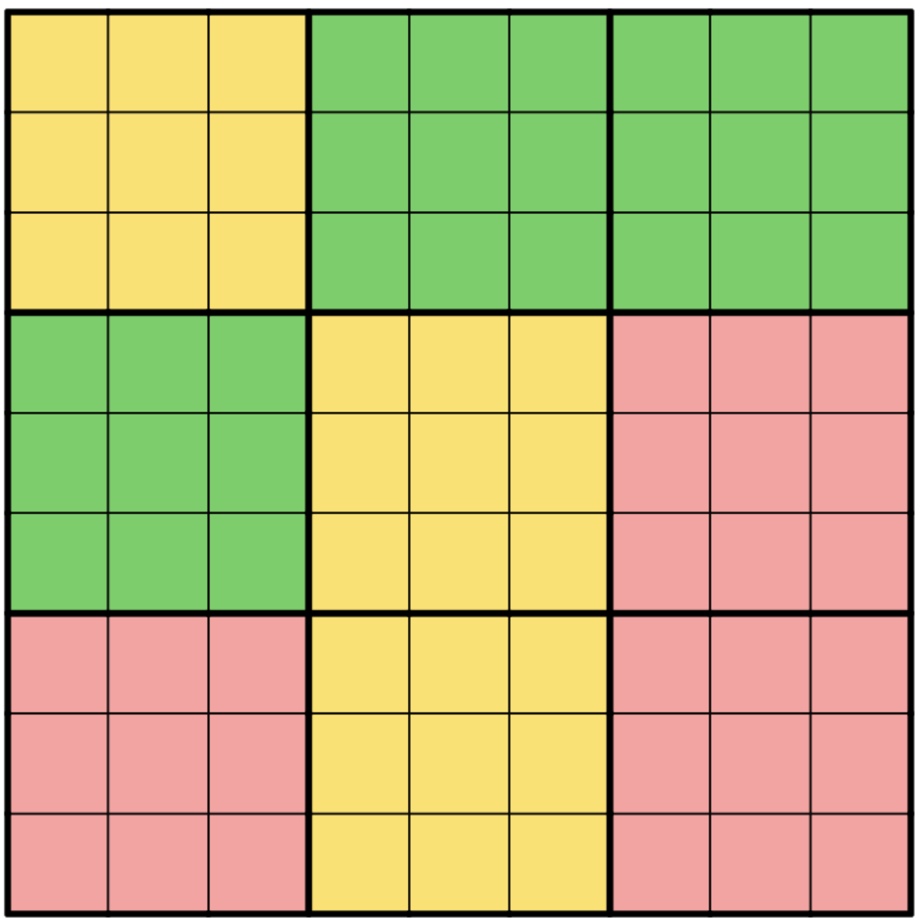
Related Works
Parallel-based optimizations
Parallel crooks algorithm – the granualirty is too fine.

Slide 22
Related Works
Parallel-based optimizations
Parallel solver based on shared memory communication
Parallel solver based on message passing communication
Parallel crooks algorithm
GPU parallel solver and others
Our goal of this project
Parallelize the 9x9 non-trivial sudoku solver

Slide 23
Outline
Introduction
Related Works
Methodology
Experimental Results
Conclusion

Slide 24
Methodology
Split search space into N mutually exclusive sub-spaces
Achieved by assigning different values to same cell
Solve each of them parallely
Sudoku Problem
Cell A Val 1
Cell B Val 2
Cell B Val 3
Cell A Val 2
Cell B Val 6
Cell C Val 4
Cell C Val 5
Cell C Val 3

Slide 25
Methodology
Split search space into N mutually exclusive sub-spaces
Achieved by assigning different values to same cell
Solve each of them parallely
Sudoku Problem
Cell A Val 1
Cell B Val 2
Cell B Val 3
Cell A Val 2
Cell B Val 6
Cell C Val 3
Cell C Val 4
Cell C Val 5

Slide 26
Methodology
The sudoku sub-problems are mutally independent with each other
Reduce the communication overhead
Crooks algorithm & cross-hatching optimization are used
Further improve the performance
Sudoku Problem
Cell A Val 1
Cell B Val 2
Cell B Val 3
Cell A Val 2
Cell B Val 6
Cell C Val 3
Cell C Val 4
Cell C Val 5
Optimized Serial Solver
Cross-hatching selection
Optimized Serial Solver

Slide 27
Outline
Introduction
Related Works
Methodology
Experimental Results
Conclusion

Slide 28
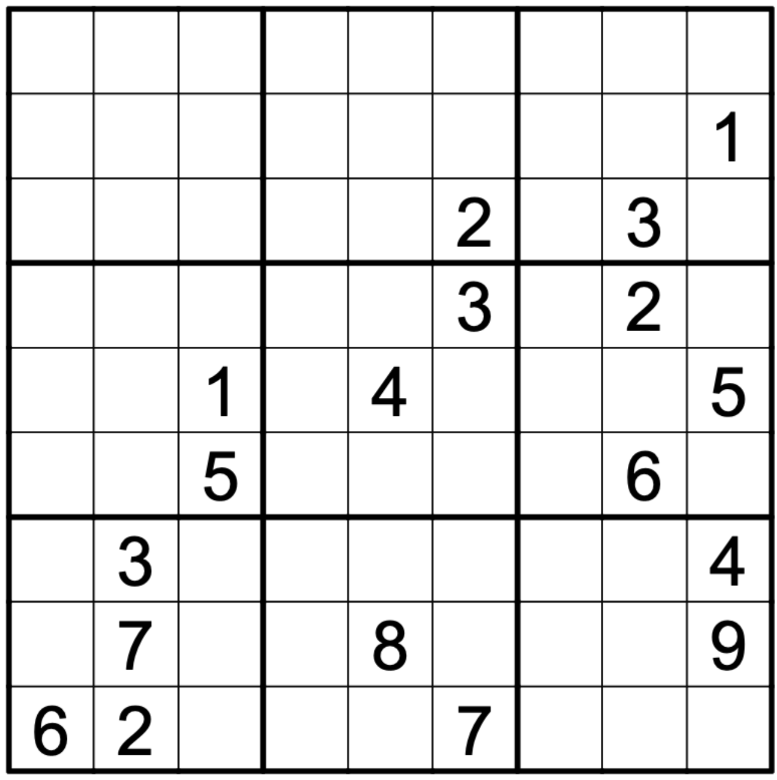
Experimental Results
2 Datasets
puzzles2_17_clue
49,158 hard sudoku puzzles
puzzles5_forum_hardest_1905_11+
48,877 even harder sudoku puzzles
Enviornment
Intel® Xeon® Silver 4214 (24 Cores)
128 GB RAM
Evaluate the performance
Using different solver
Using different number of threads

Slide 29
Experimental Results – Serial Solver Baseline
Serial Solver | Average Solved Time | Search Space Size
Backtracking Solver | >1 sec | > 5M
+ Crooks Algorithm Pruning | 0.92 ms | 121
+ Crooks + Cross Hatching | 0.44 ms | 76
puzzles2_17_clue
Serial Solver | Average Solved Time (ms) | Search Space Size
Backtracking Solver | > 50 ms | > 300K
+ Crooks Algorithm Pruning | 2.69 ms | 346
+ Crooks + Cross Hatching | 1.93 ms | 278
puzzles5_forum_hardest_1905_11+

Slide 30
Experimental Results – Parallel Solver Performance
Dataset: puzzles2_17_clue
Serial Optimization | No. of Thread | Avg Solved Time | Search Space Size | Relative Perf. | Parallel Eff.
+ Crooks Algorithm Pruning | 1 | 0.92 ms | 121 | 1 | 1
 | 2 | 0.72 ms | 82 | 1.27 | 0.63
 | 4 | 0.37 ms | 38 | 2.46 | 0.61
 | 8 | 0.24 ms | 21 | 3.76 | 0.47
 | 16 | 0.19 ms | 13 | 4.72 | 0.30
+ Crooks + Cross Hatching | 1 | 0.44 ms | 76 | 1 | 1
 | 2 | 0.27 ms | 31 | 1.63 | 0.82
 | 4 | 0.15 ms | 14 | 2.96 | 0.74
 | 8 | 0.10 ms | 6 | 4.36 | 0.55
 | 16 | 0.09 ms | 4 | 4.57 | 0.29

Slide 31
Experimental Results – Parallel Solver Performance
Dataset: puzzles2_17_clue
Serial Optimization | No. of Thread | Avg Solved Time | Search Space Size | Relative Perf. | Parallel Eff.
+ Crooks Algorithm Pruning | 1 | 0.92 ms | 121 | 1 | 1
 | 2 | 0.72 ms | 82 | 1.27 | 0.63
 | 4 | 0.37 ms | 38 | 2.46 | 0.61
 | 8 | 0.24 ms | 21 | 3.76 | 0.47
 | 16 | 0.19 ms | 13 | 4.72 | 0.30
+ Crooks + Cross Hatching | 1 | 0.44 ms | 76 | 1 | 1
 | 2 | 0.27 ms | 31 | 1.63 | 0.82
 | 4 | 0.15 ms | 14 | 2.96 | 0.74
 | 8 | 0.10 ms | 6 | 4.36 | 0.55
 | 16 | 0.09 ms | 4 | 4.57 | 0.29

Slide 32
Experimental Results – Parallel Solver Performance
Dataset: puzzles5_forum_hardest_1905_11+
Serial Optimization | No. of Thread | Avg Solved Time | Search Space Size | Relative Perf. | Parallel Eff.
+ Crooks Algorithm Pruning | 1 | 2.69 ms | 346 | 1 | 1
 | 2 | 1.97 ms | 233 | 1.36 | 0.68
 | 4 | 0.96 ms | 112 | 2.80 | 0.70
 | 8 | 0.67 ms | 70 | 4.00 | 0.50
 | 16 | 0.47 ms | 41 | 5.67 | 0.35
+ Crooks + Cross Hatching | 1 | 1.93 ms | 278 | 1 | 1
 | 2 | 1.20 ms | 155 | 1.61 | 0.80
 | 4 | 0.66 ms | 84 | 2.91 | 0.73
 | 8 | 0.43 ms | 47 | 4.55 | 0.57
 | 16 | 0.37 ms | 28 | 5.21 | 0.33

Slide 33
Experimental Results – Parallel Solver Performance
Dataset: puzzles5_forum_hardest_1905_11+
Serial Optimization | No. of Thread | Avg Solved Time | Search Space Size | Relative Perf. | Parallel Eff.
+ Crooks Algorithm Pruning | 1 | 2.69 ms | 346 | 1 | 1
 | 2 | 1.97 ms | 233 | 1.36 | 0.68
 | 4 | 0.96 ms | 112 | 2.80 | 0.70
 | 8 | 0.67 ms | 70 | 4.00 | 0.50
 | 16 | 0.47 ms | 41 | 5.67 | 0.35
+ Crooks + Cross Hatching | 1 | 1.93 ms | 278 | 1 | 1
 | 2 | 1.20 ms | 155 | 1.61 | 0.80
 | 4 | 0.66 ms | 84 | 2.91 | 0.73
 | 8 | 0.43 ms | 47 | 4.55 | 0.57
 | 16 | 0.37 ms | 28 | 5.21 | 0.33

Slide 34
Experimental Results – Breakdown Analysis
Serial Splitting → Parallel Solving
Serial Splitting
Parallel Solving
Serial Splitting
Parallel Solving

Slide 35
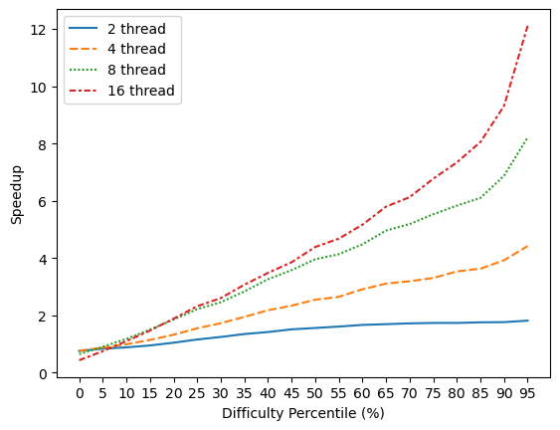
Experimental Results – Breakdown Analysis
Split the dataset into 20 groups according to 1-thread-solved-time
The speedup is highly related to the difficulty of sudoku puzzles

Slide 36
Experimental Results
Abalation study
# branches

Slide 37
Outline
Introduction
Related Works
Methodology
Experimental Results
Conclusion

Slide 38
Conclusion
In this project, we parallelize the optimized serial sudoku solver and achieve at most 5.67x speedup
Efficient serial algorithm is necessary, while parallelism could push the performance further
Significat improvement is observed when the given sudoku problem is harder

Slide 39
Contribution
呂承哲: Serial & Parallel Program, Presentation
劉紘華: Parallel Program
邱恆毅: Experimental Summary

